Slide 1

IMAGE STYLE TRANSFER
LE CHI ANH - 20224296
NGUYEN TRONG NGHIA - 20224274

Slide 2
TABLE OF CONTENTS
Introduction
Methods
Experiments
Results
Challenges and future works
References

Slide 3
1.Introduction
Definition: Technique to blend the artistic style of one image ("style image") with the structural content of another image ("content image").
Application:
Artistic rendering (turn photos into Van Gogh- like paintings)
Photo editing (customizable filters)
Game design and animation (unique visual effects)
Virtual and Augmented Reality (AR filters, immersive designs

Slide 4
1.Introduction
Objective:
Generate a new image that preserves the content of the original image while adopting the style of a reference image.
Key Components:
Content loss: Ensures that the output image retains the spatial structure of the content image.
Style loss: Captures textures, patterns, and color distributions from the style image.
Why CNNs?:
CNNs learn hierarchical feature representations, making them ideal for isolating style and content features at different layers.

Slide 5
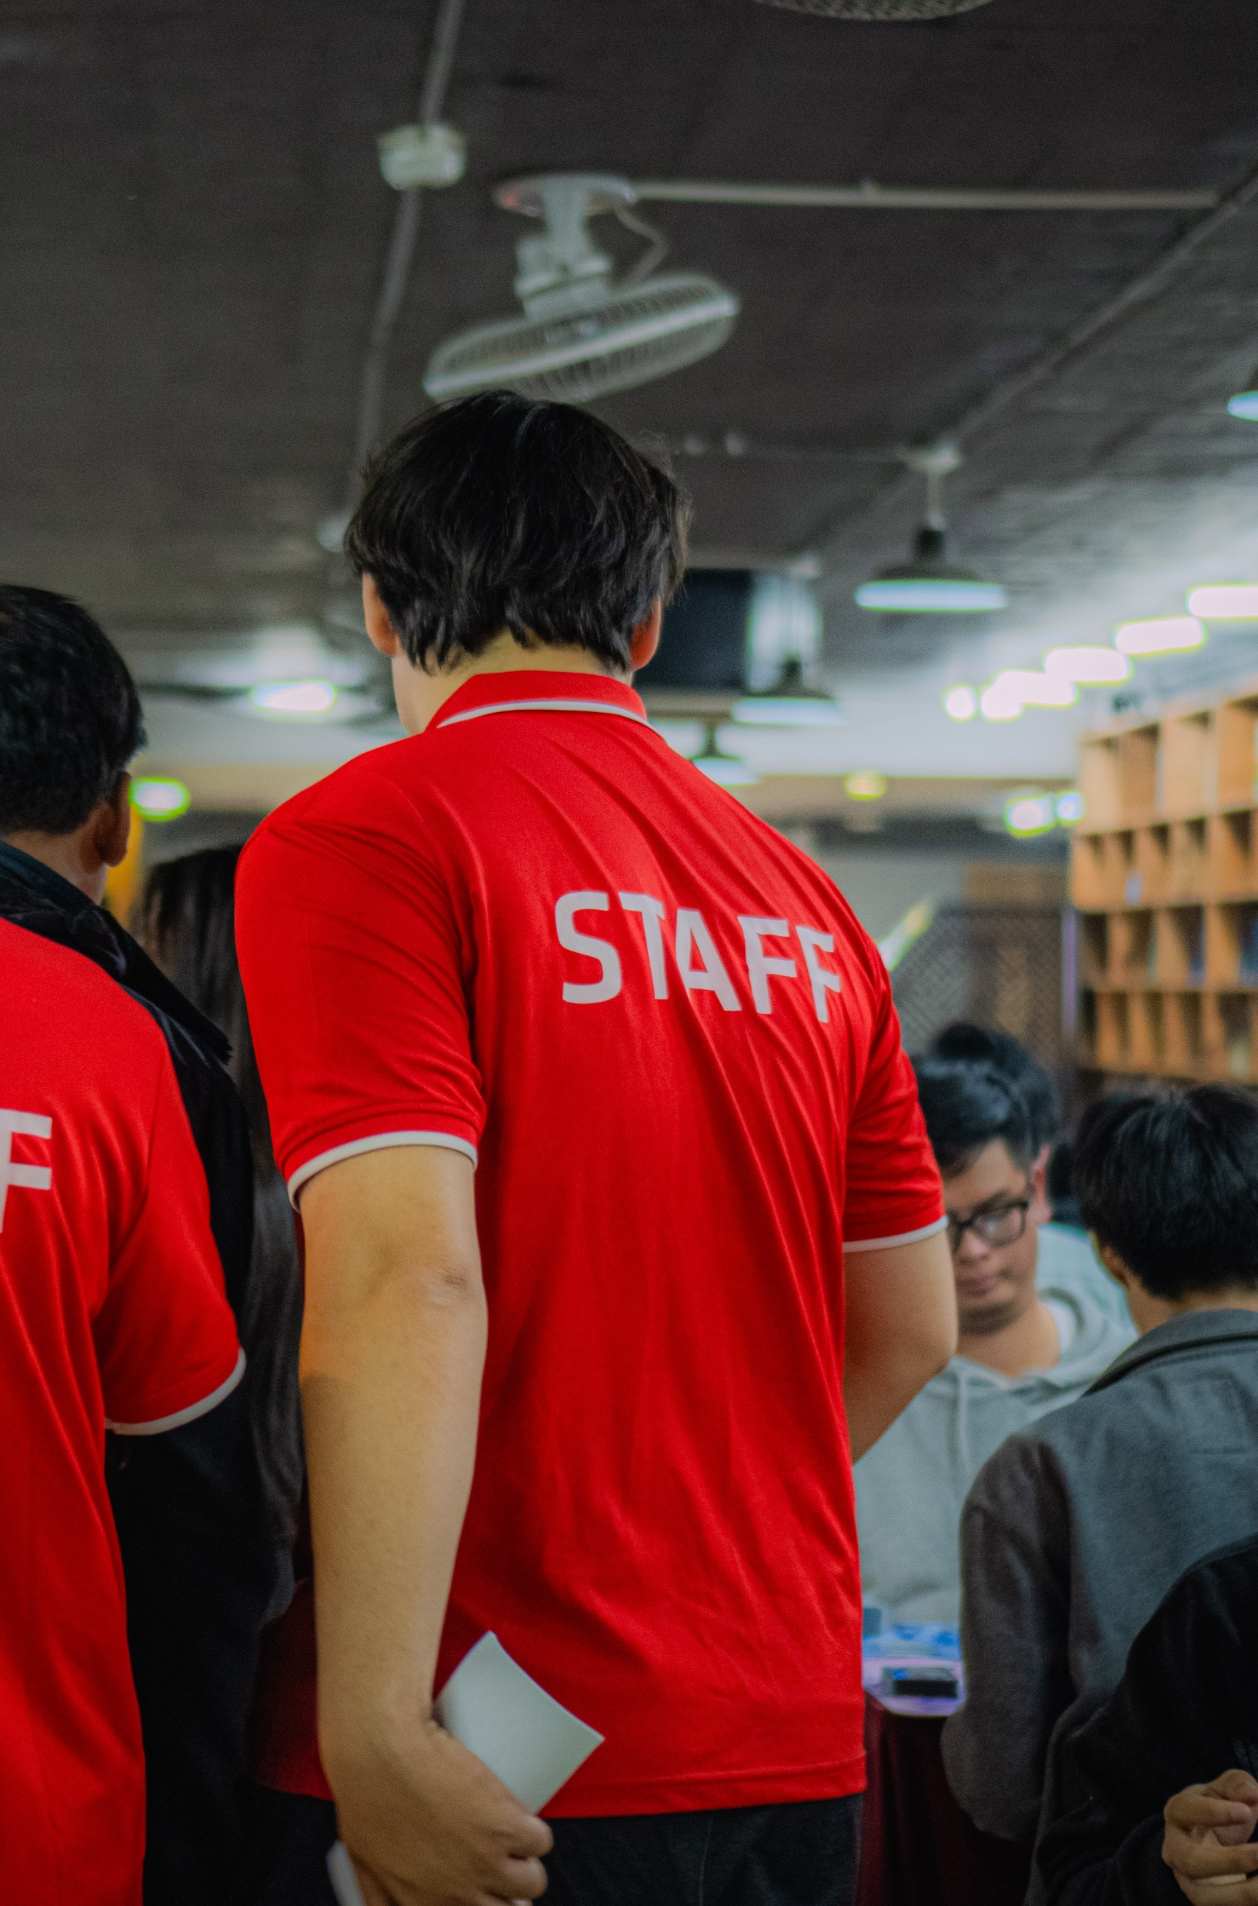

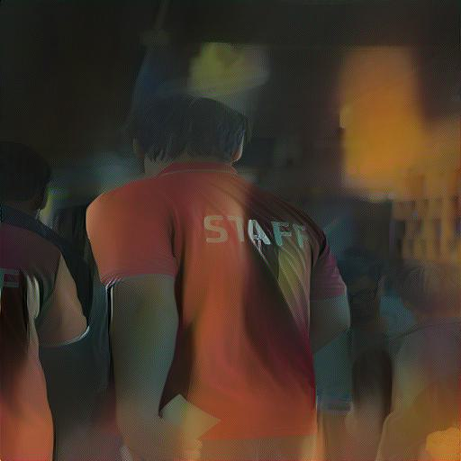
1.Introduction
+
=
Content image
Style image
Output image

Slide 6
2. Methods
VGG-19: A widely used CNN trained on ImageNet.
Activations in deeper layers encode content.
Activations in shallower layers encode style.
CNN: Essential for feature extraction from images.
Image to fixed resolution: 512x512
Extracted feature: Content feature, Style feature

Slide 7
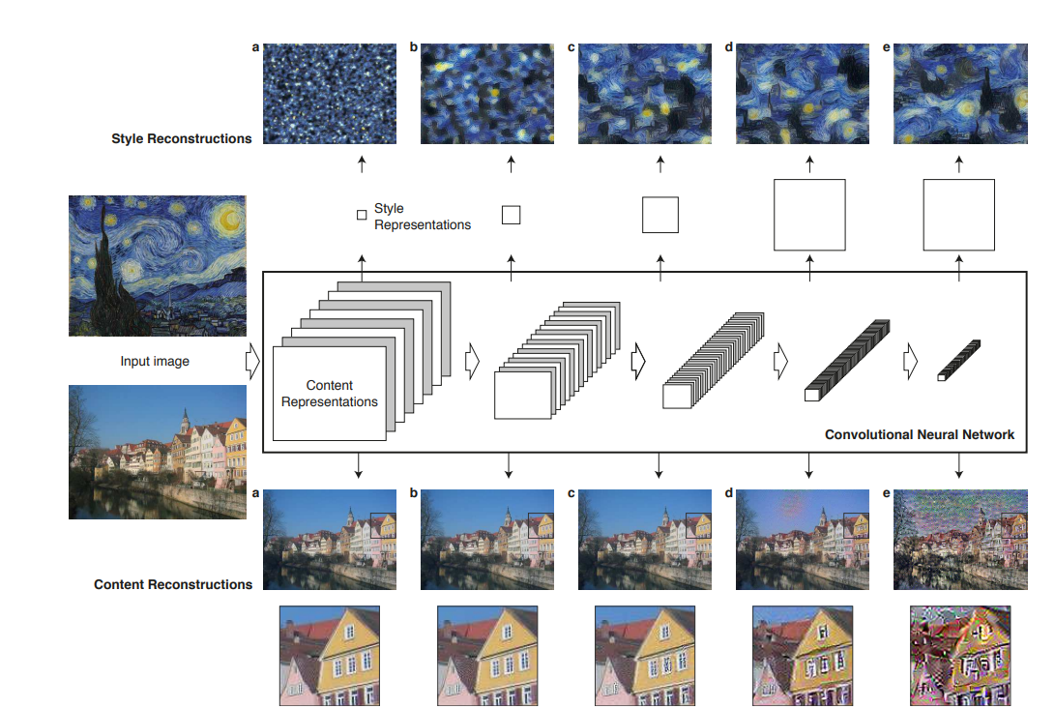
2.methods
Step to do: https://www.cvfoundation.org/openaccess/content_cvpr_2016/papers/Gatys_Image_Style_Transfer_CVPR_2016_paper.pdf

Slide 8
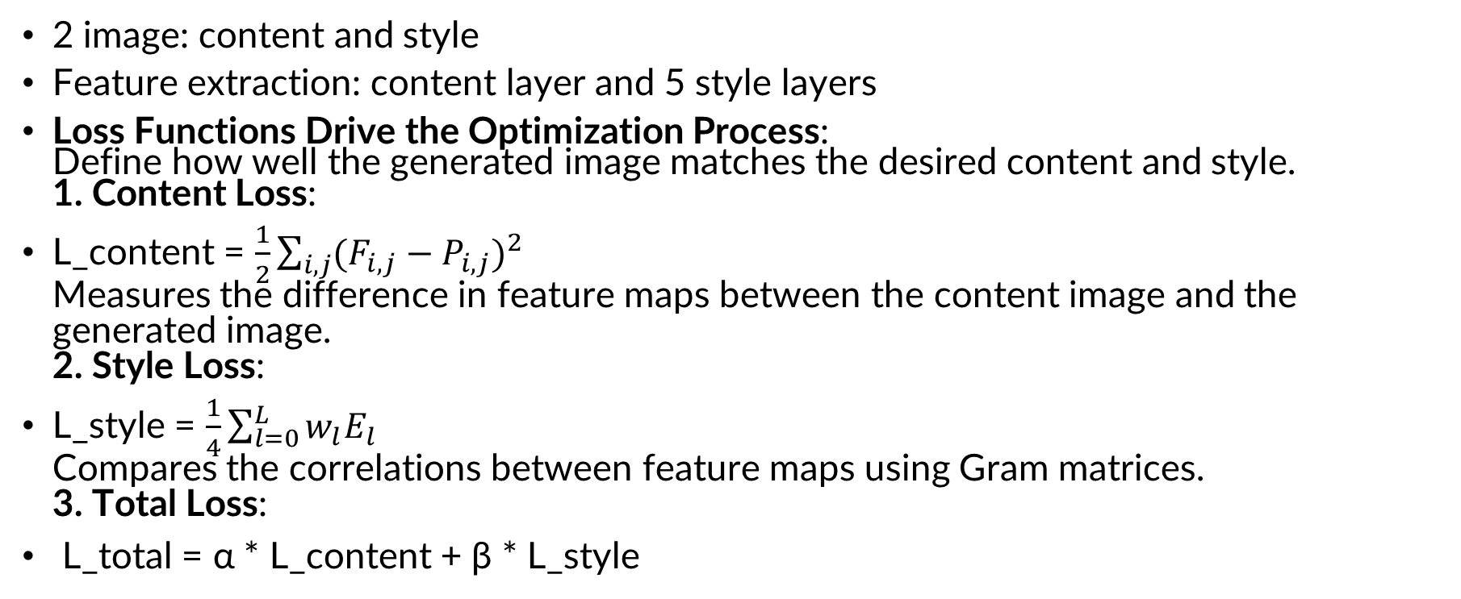
3.Experiments
2 image: content and style
Feature extraction: content layer and 5 style layers
Loss Functions Drive the Optimization Process: Define how well the generated image matches the desired content and style. 1. Content Loss:
L_content = $\frac{1}{2}\sum_{i,j}{{{(F}_{i,j} − P_{i,j})}^{2}}$ Measures the difference in feature maps between the content image and the generated image. 2. Style Loss:
L_style = $\frac{1}{4}\sum_{l=0}^{L}{w_{l}E_{l}}$ Compares the correlations between feature maps using Gram matrices. 3. Total Loss:
L_total = α * L_content + β * L_style
The loss function from: https://www.cvfoundation.org/openaccess/content_cvpr_2016/papers/Gatys_Image_Style_Transfer_CVPR_2016_paper.pdf

Slide 9
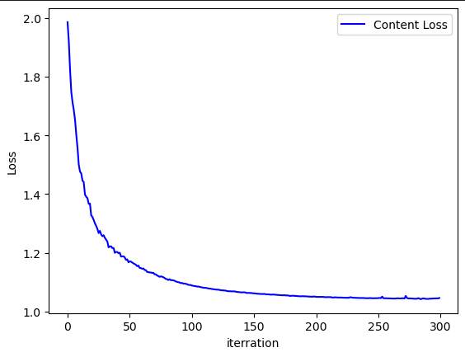
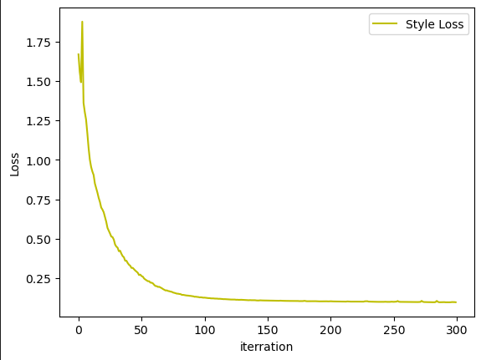
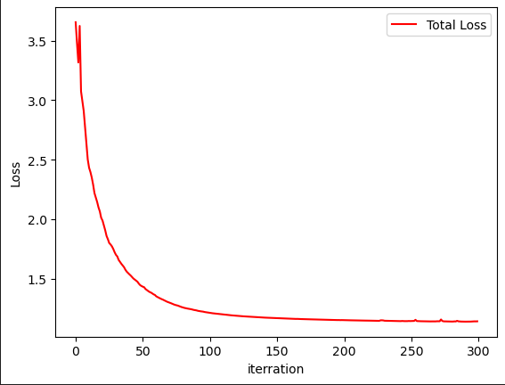
4. Result
Content loss
Style loss
Total loss

Slide 10
4.Result
+
=
Content image
Style image
Output image

Slide 11
5. Challenges and future works
High Computational Cost: Requires GPUs for real-time applications.
Temporal Consistency: Difficult to apply consistently across video frames.
Style Generalization: Models struggle with entirely new styles or complex input.

Slide 12
5. Challenges and future works
Faster Techniques: Explore GANs and lightweight models for real-time performance.
Multimodal Style Transfer: Combine multiple styles in a single output.

Slide 13
6. Reference
Image Style Transfer Using Convolutional Neural Networks: cv-foundation.org/openaccess/content_cvpr_2016/papers/Gatys_Image_Style_Transfer_CVPR_2016_paper.pdf
GitHub code:
https://github.com/Aleadinglight/Pytorch-VGG-19/blob/master/VGG_19.ipynb

Slide 14
THANK YOU !

